Slide 1



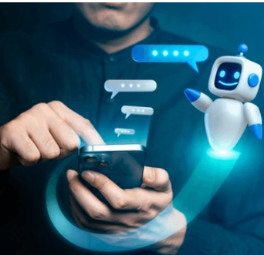
Natural Language Processing and Computer Vision and ChatBot
Natural language
Processing
Computer Vision
ChatBot

Slide 2
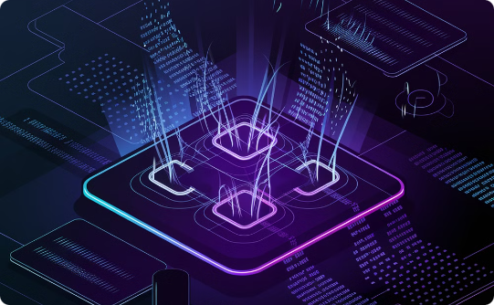

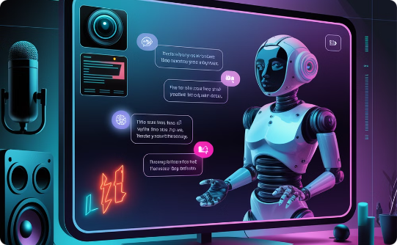
What is Natural Language Processing (NLP)?
Understanding Human Language
Bridging the Gap
Wide Applications
NLP enables computers to understand, interpret, and generate human language. This includes tasks like text analysis, translation, and dialogue systems.
NLP acts as a bridge between human language and computer processing, enabling machines to effectively interact with humans.
NLP finds applications in various fields, including search engines, virtual assistants, customer service chatbots, and machine translation.

Slide 3
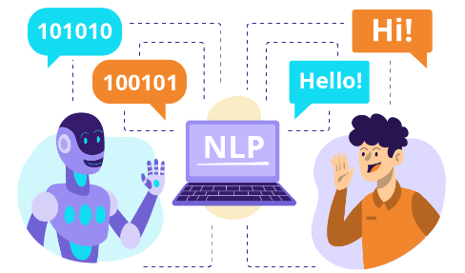
Steps in Natural Language Processing (NLP)?
Text Collection: Gather text data (e.g., articles, tweets).
Text Cleaning: Remove unwanted elements (punctuation, stop words).
Tokenization: Break text into words or sentences.
Stemming/Lemmatization: Reduce words to their base form (e.g., "running" to "run").
Vectorization: Convert words into numbers (using techniques like TF-IDF or Word Embeddings).
Model Training: Use algorithms to learn patterns in the data.
Evaluation: Check model performance (accuracy, precision).
Deployment: Use the model in applications (e.g., chatbots).

Slide 4
Brief History of NLP
1950s
1
Early research focused on machine translation.
1960s-1970s
2
Development of rule-based systems for language processing.
1980s-1990s
3
Emergence of statistical methods and machine learning techniques.
2000s-Present
4
Deep learning revolutionizes NLP, leading to significant advancements in language understanding and generation.
The history of NLP is a journey of innovation and evolution. NLP started as a purely rule-based approach in the 1950s, and it has steadily evolved through statistical methods, machine learning techniques, and now deep learning.

Slide 5
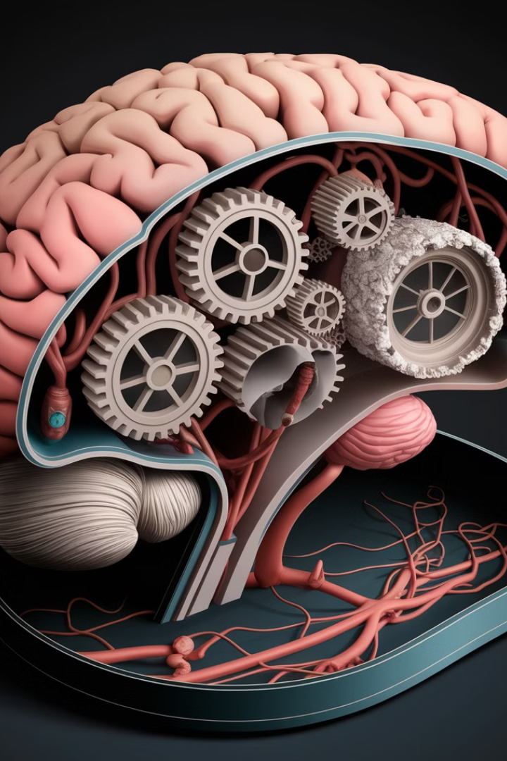



Core NLP Tasks: Tokenization, Lemmatization, Stemming
Tokenization
Breaking down text into individual units, like words or punctuation marks(e.g., "I love learning
about AI!" - ["I", "love", "learning", "about", "AI", "!"].
Lemmatization
Lemmatization: Converting words to their base form using proper grammar
(e.g., "running" to "run").
Stemming
Cutting words down to their root form by removing suffixes (e.g., For words like "playing," "played,"
and "plays":, Stemming cuts them down to the root form: "play").
Notes:
For words like "playing," "played," and "plays":

Slide 6
Named Entity Recognition
Definition:
Types of Entities
Benefits
Purpose:
Named entities are words or phrases that represent specific names, like people, places, organizations, dates, etc.
Include Person (e.g., "Elon Musk"), Location (e.g., "Paris"), Organization (e.g., "Google"), Date (e.g., "January 2023"), among others.
Improved information extraction
For the sentence, "Amazon was founded by Jeff Bezos in Seattle in 1994."
Person: "Jeff Bezos"
Organization: "Amazon"
Location: "Seattle"
Date: "1994"
Enhanced text understanding
More accurate chatbot responses

Slide 7

Sentiment Analysis
1
1. Identifying Emotions
2
2. Textual Data
Sentiment analysis determines the emotional tone of text, whether positive, negative, or neutral.
It can be applied to various forms of text, including reviews, social media posts, and customer feedback.
3
3. Business Applications
4
4. Social Listening
Sentiment analysis is valuable for businesses to understand customer satisfaction, market trends, and brand reputation.
It helps monitor public opinion about a topic, product, or brand, providing insights for decision-making.

Slide 8

Text Summarization
Automatic Extraction
Abstractive Summarization
Key Applications
Algorithms identify key phrases, sentences, or paragraphs, capturing the essence of the text.
The system creates a concise summary in its own words, understanding the main points and relationships.
Text summarization simplifies large documents, improves user experience, and facilitates information retrieval.

Slide 9





Machine Translation
Language Conversion
Multilingual Communication
Machine translation converts text from one language to another.
It facilitates communication across language barriers.
Natural Language Understanding
Artificial Intelligence
Machine translation leverages AI algorithms to analyze and translate text.
It involves understanding the context of language.

Slide 10
What is Computer Vision (CV)?
Understanding Human Language
Bridging the Gap
Wide Applications
Computer vision interprets visual data to recognize and categorize objects and actions, enabling machines to "understand" scenes visually. For example, When a customer walks by, the camera can identify them and recognize they are holding a shopping bag.
It bridges the gap between human vision and computer understanding by training systems to recognize objects, scenes, and actions in images or videos.
It’s used in facial recognition, autonomous vehicles, medical image analysis, security, and retail to improve efficiency and accuracy across industries.

Slide 11
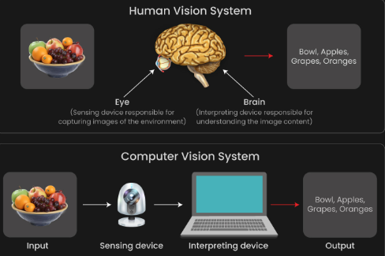
Steps in Computer Vision (CV)?
Image Collection: Gather images or videos.
Preprocessing: Resize, normalize, and enhance images.
Annotation: Label images (e.g., mark objects in images).
Feature Extraction: Identify important features (edges, shapes).
Model Training: Train algorithms to recognize patterns in images.
Evaluation: Assess model performance (accuracy, recall).
Deployment: Implement the model in real-world applications (e.g., facial recognition).

Slide 12
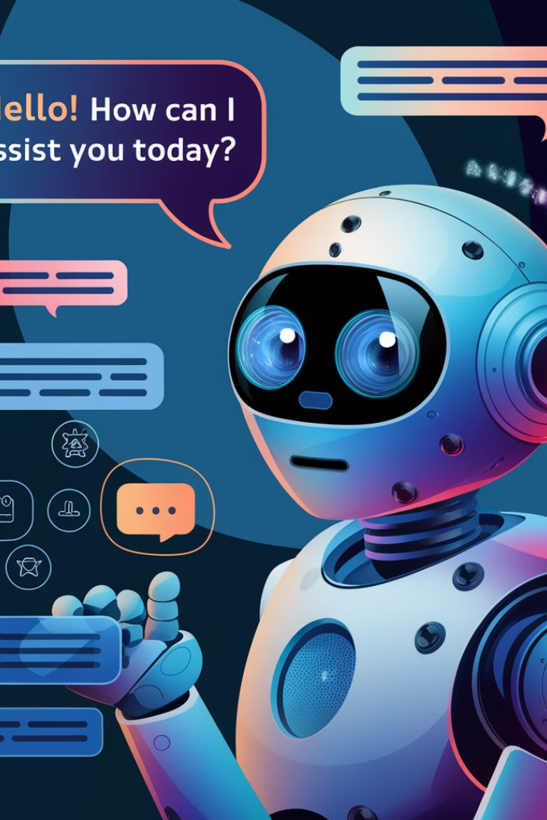
How Chatbots Utilize NLP
1
Understanding User Input
NLP techniques, like tokenization, stemming, and named entity recognition, enable chatbots to process and understand user input.
2
Generating Responses
Chatbots use NLP to generate responses that are relevant, coherent, and sound natural to the user.
3
Contextual Awareness
refers to the ability of a chatbot to understand the context of a conversation. This means the chatbot can remember previous messages, recognize the topic being discussed, and respond appropriately based on that context.

Slide 13
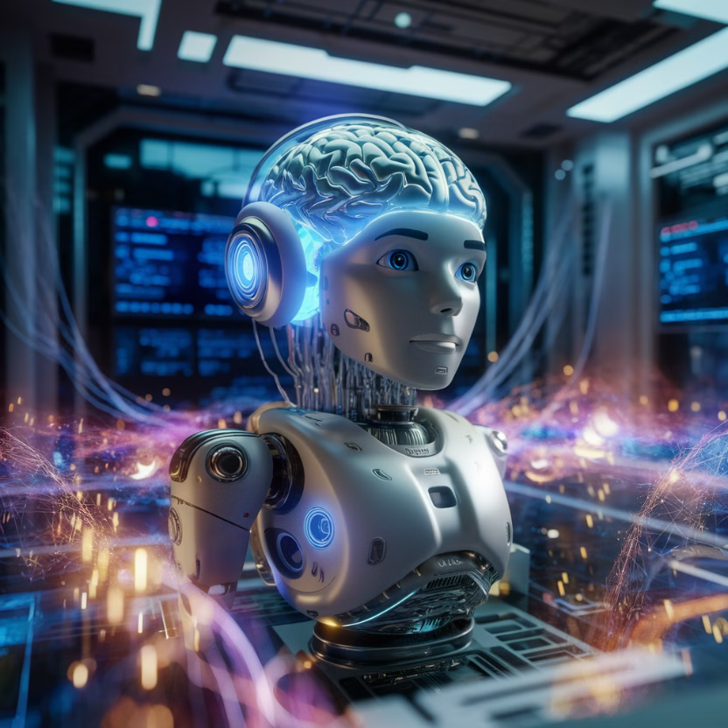
Chatbot Architecture and Components
User Interface (UI): Where users chat with the bot (e.g., website or app).
Natural Language Processing (NLP): Helps the bot understand user language.
Dialogue Management: Controls the conversation flow and context.
Knowledge Base: Stores information for the bot to answer queries.
Response Generation: Forms replies for user interactions.
Integration Layer: Connects to external systems for live data.
Learning Module: Enables the bot to learn from user interactions.
Analytics and Monitoring: Tracks performance and user feedback for improvement.

Slide 14
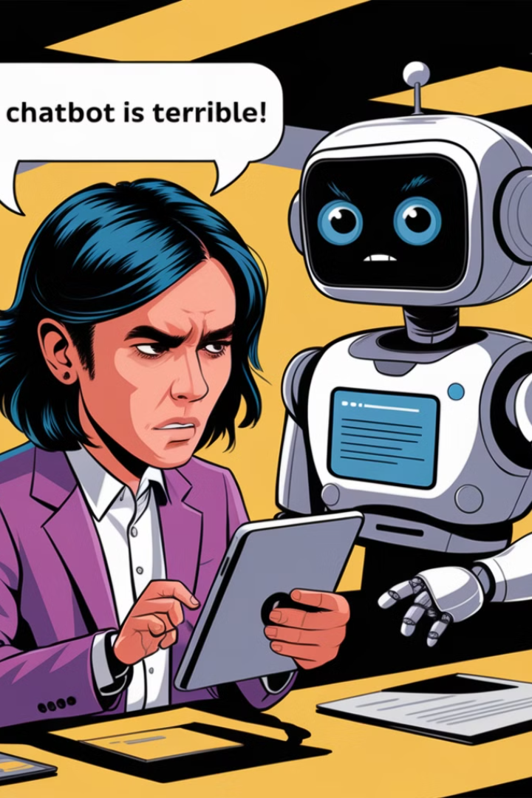
Challenges in Chatbot Development
Contextual Understanding
Data Bias
Chatbots can struggle to interpret complex conversations, nuances of language, and user intent.
Training data may reflect existing biases, leading to chatbot responses that are discriminatory or perpetuate stereotypes.
Limited Memory
User Frustration
Chatbots often have difficulty remembering past interactions, making conversations feel disjointed or repetitive.
When chatbots fail to meet user expectations, they can cause frustration and lead to negative user experiences.

Slide 15
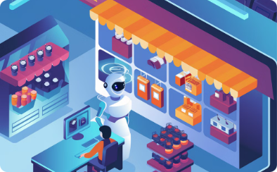
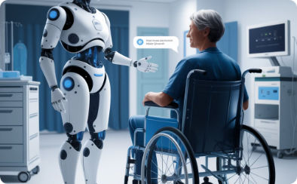


Use Cases and Applications of Chatbots
E-commerce
Healthcare
Customer Service
Education
Chatbots provide 24/7 customer service, answer product questions, and assist with purchases.
Chatbots offer health information, schedule appointments, and provide personalized health advice.
Chatbots handle routine inquiries, resolve issues, and provide quick responses to common questions.
Chatbots provide personalized learning experiences, answer student questions, and offer interactive tutorials.

Slide 16
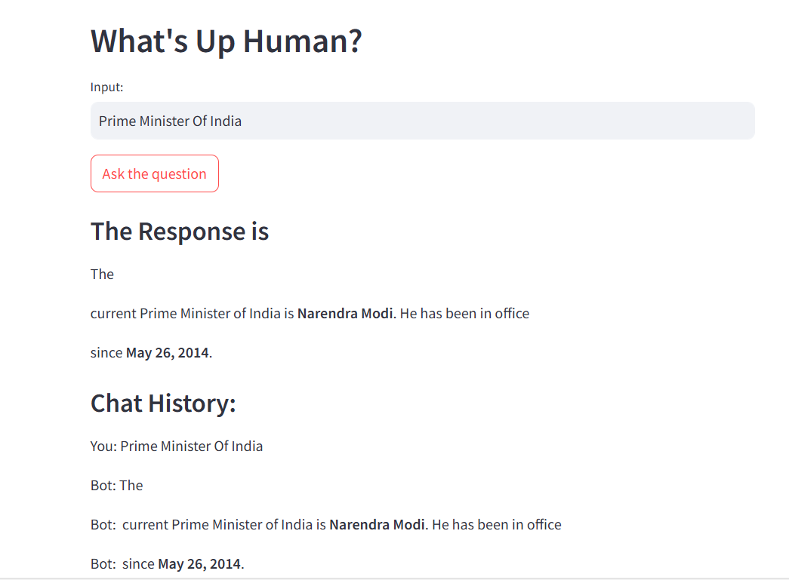

Slide 17

Future Trends and Advancements in NLP and Chatbots
NLP and chatbot technologies are rapidly evolving, driven by advancements in deep learning, natural language understanding, and human-computer interaction.
These advancements are paving the way for more sophisticated, personalized, and context-aware conversational experiences.
100M
Chatbots
Projected global market value by 2025
10%
NLP
Annual growth rate in the NLP market
90%
Customers
Satisfied by chatbot interactions

Slide 18

Q&A and discussion
Let's discuss the potential and implications of AI.
1.What is a sentiment analysis in NLP?
2.How do self-driving cars use Computer Vision?
3.How do chatbots improve customer service?

